Slide 1
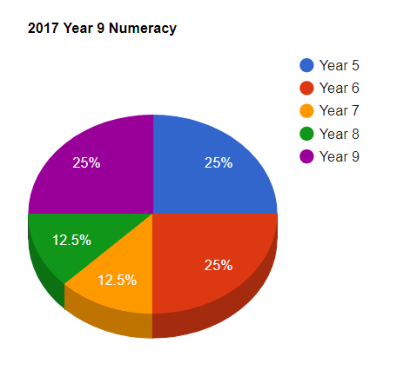
Non-Calculator section question breakdown by year level
Complete the non-calculator section to the best of your ability in 10 minutes.

Slide 2
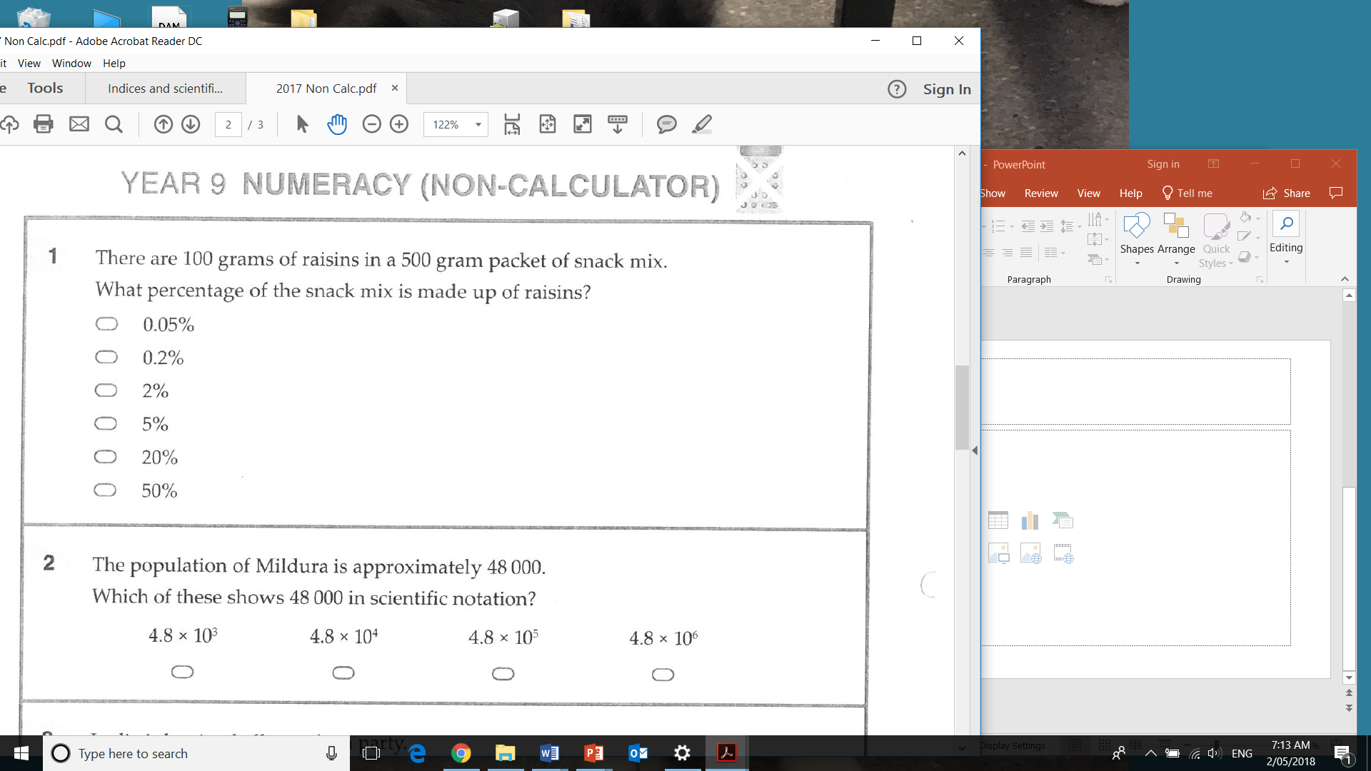
Band 7
Solution: 20%

Slide 3
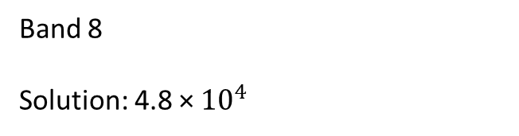
Band 8
Solution: 4.8 × ${10}^{4}$

Slide 4
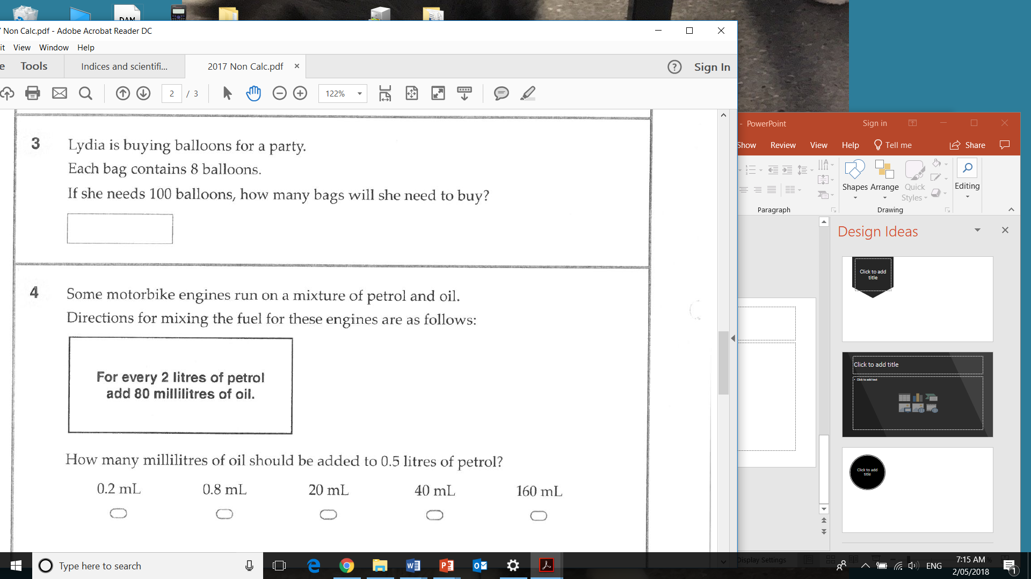
Band 8
Solution: 13

Slide 5
Band 7
Solution: 20 mL

Slide 6
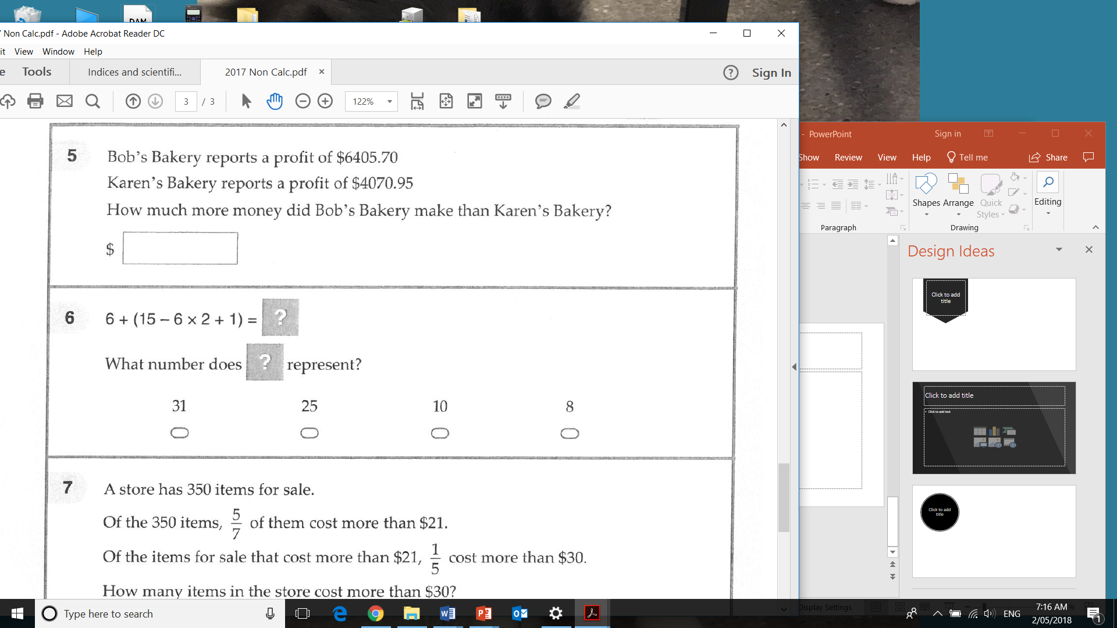
Band 8
Solution: 2334.75

Slide 7
Band 9
Solution: 10

Slide 8
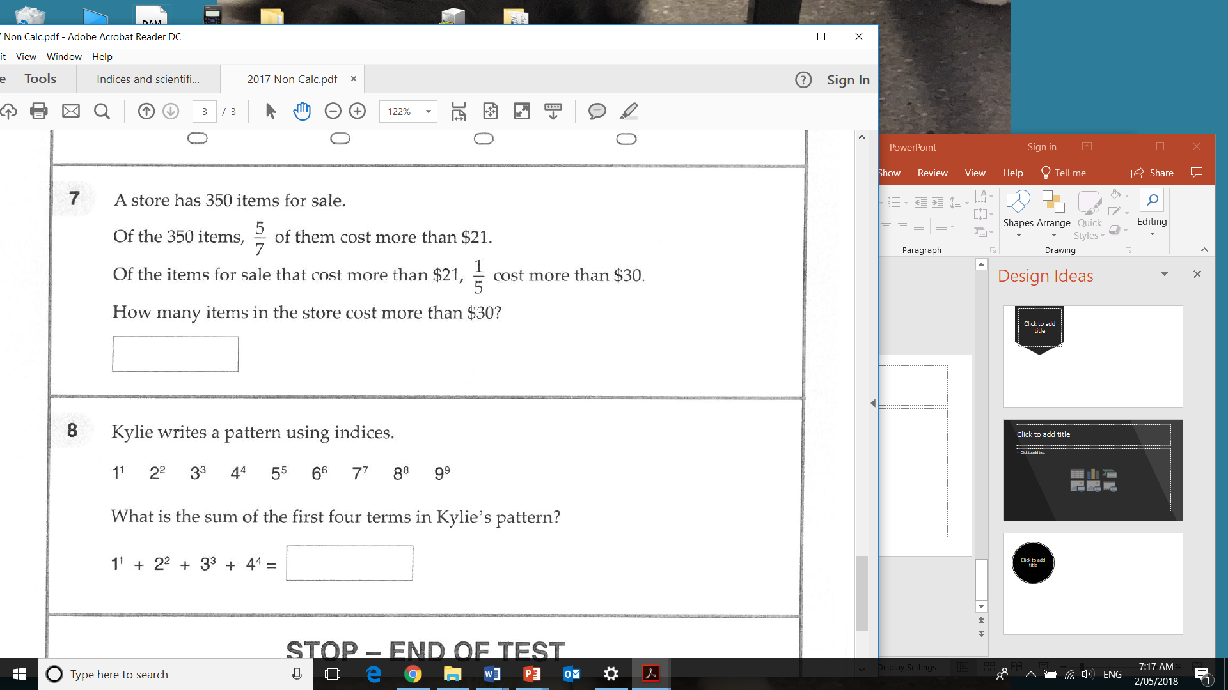
Band 10
Solution: 50

Slide 9
Band 10
Solution: 288

